Slide 1

Game Master Admin Tool
By Kyle Hansen
12/06/2020

Slide 2
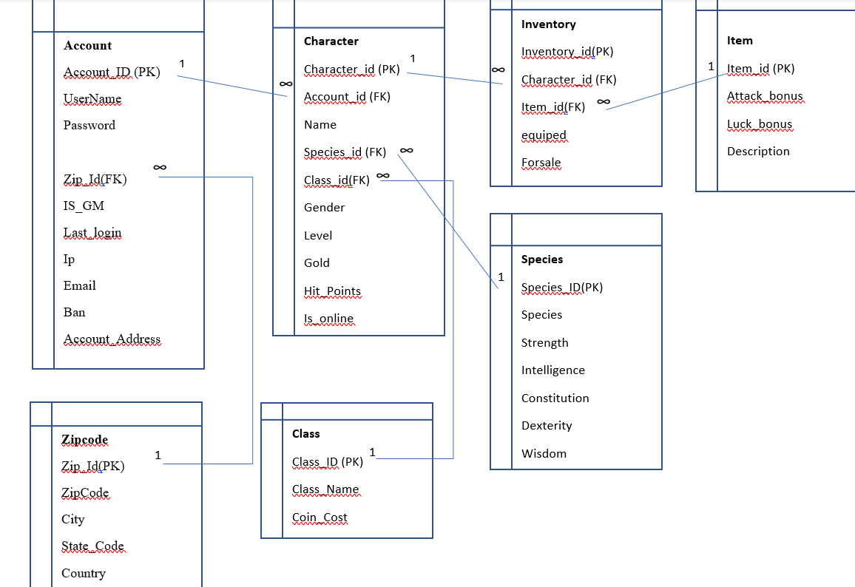
The Game Master Admin Tool is C# WinForms front-end admin tool for game database that I designed as my final project in CIT 178.

Slide 3
The application has the following features:
Connect to SQL Server via the Game account
Handle error conditions
Proceed if connected
Logon Screen for the game administrator
Check and validate username/password
Verify that the user is an admin (GM)
Handle error conditions
Application functionality
Add new user
Set/change theme
See list of users and information on users
Upgrade user to admin
Remove admin rights from user
Report showing all virtual items for sale by game users
Ban user
In application help documentation
Reports( “species and stats”, “Character Roles”)
Log off

Slide 4
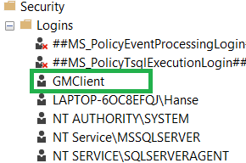
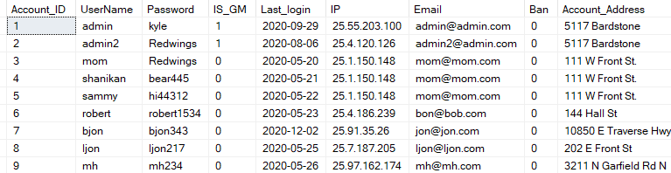
Authentication
We have two layers of authentication.
The first layer is SQL authentication (GMclient account). Can the Game Master Admin Toll connect to the SQL server backend database?
The second layer of authentication is table driven. Once the GMclient is connected does a particular username/password combination exist and does that username/password combination have admin privileges.

Slide 5
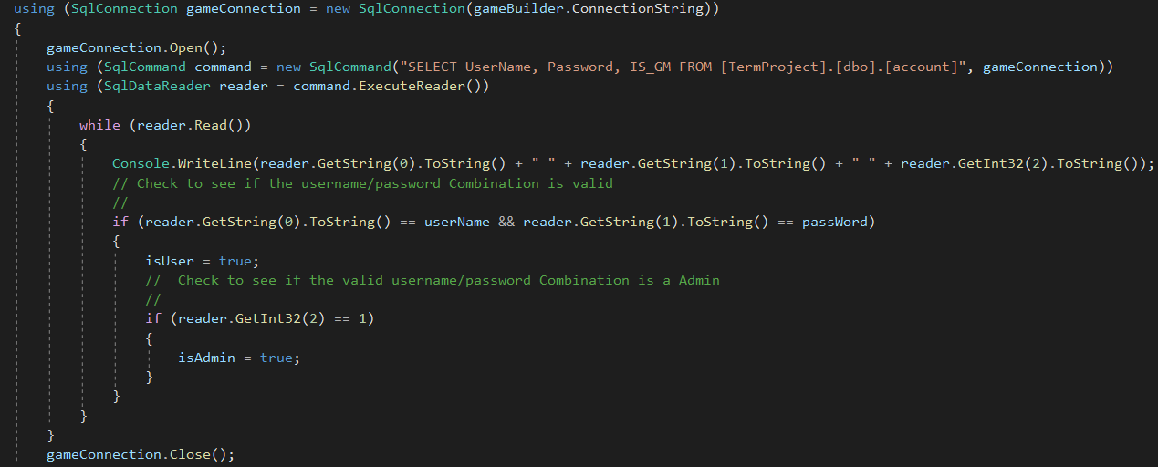
Authentication Code
At the center of the Authentication code we have the CheckLogon() method:
public (bool isUser, bool isAdmin, bool isConnect) CheckLogon(string userName, string passWord)

Slide 6
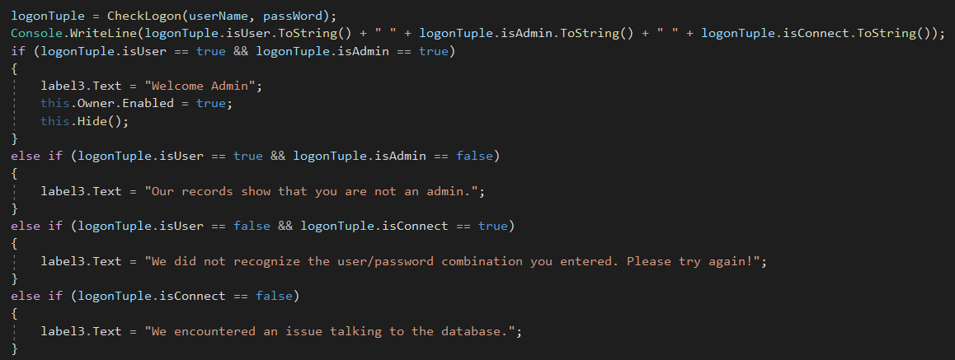
Authentication Logic
Once the CheckLogon() method returns the Tuple we need to perform validation logic for 4 possible actions:
1.) Valid Admin proceed with program 2.) Database connection issue inform the user 3.) Valid user, but not an admin 4.) Did not find user/password combination

Slide 7
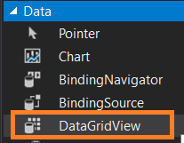
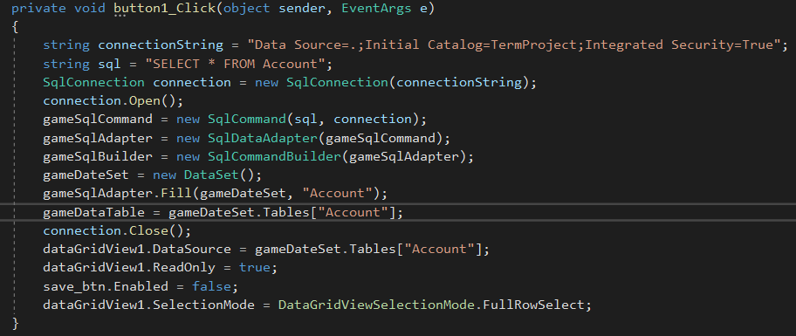
Updating data in the database via a DataGridView.
Buttons that interact with the DataGridView were created to handle viewing and updating the database.
Code behind the Pull Accounts button:

Slide 8
Considerations for future versions and takeaways from this project:
I would like to make an actual game that works with this Admin Tool and database. Currently the game is just hypothetical.
I would also like to add some aesthetically pleasing artwork and or screen captures from the game to the Admin Tool.
My two largest takeaways from this project are:
An understanding of WinForms
A better understanding of the time it takes to implement an application. I wrote a small application, and it took a large amount of time.

